Slide 1
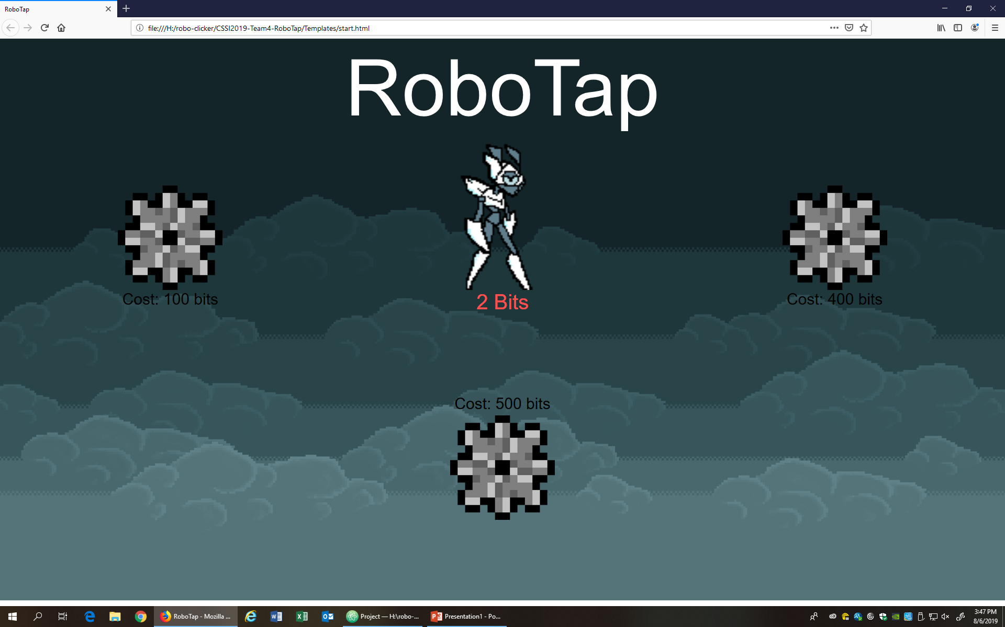
Robotap End of Day 2
-Added robot skin purchase
-File reformat
-Localhost Set up
-Debugging

